Slide 1

CARBON NEUTRALITY
Creativity & Innovation in Achieving a Sustainable Future
By Zero Carbon Crew
P1
BATCH 2024-25

Slide 2

Carbon Emissions & It’s Impact
Carbon emissions, primarily carbon dioxide (CO2), are the release of carbon into the atmosphere.
Sources – Fossil Fuel Burning, Deforestation, etc.
Impact of Carbon Emission
Greenhouse Effect: CO2 and other greenhouse gases trap heat in the atmosphere, leading to a rise in global temperatures.
Climate Change: Increased greenhouse gas concentrations cause climate change, resulting in extreme weather events, rising sea levels, and other negative impacts.

Slide 3
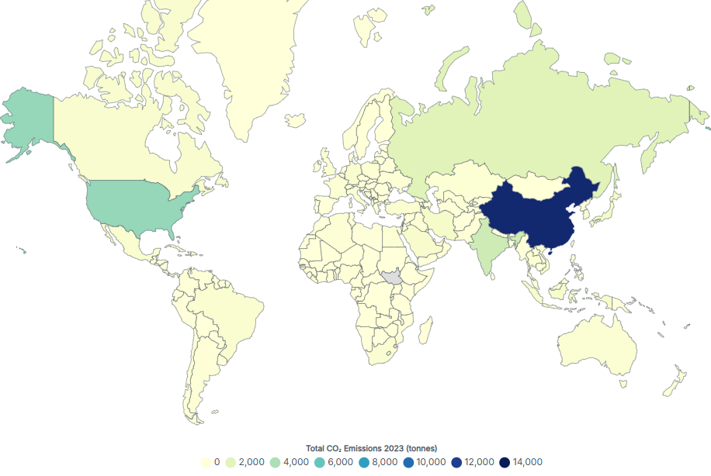
Global CO₂ Emissions in 2023: A Visual Representation

Slide 4

OUR AIM: CARBON NEUTRALITY
The aim of carbon neutrality is to balance carbon emissions by ensuring that any emitted carbon is offset by an equivalent amount of carbon removal
Carbon neutrality = Carbon emissions - Carbon removal = Net zero

Slide 5
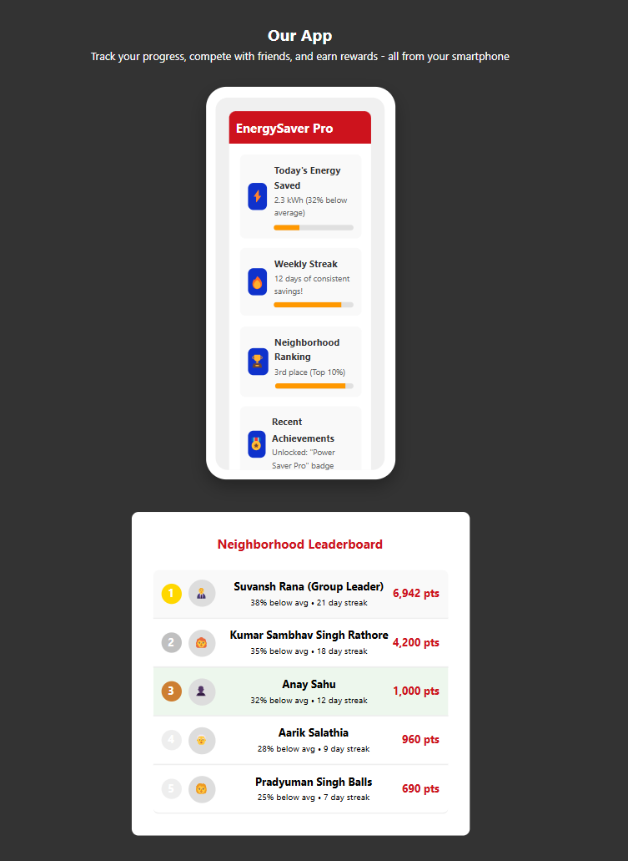
How are we planning to achieve it?
Gamifying Energy Conservation: Fun, Competition, and Rewards for a Greener Future
This includes :
Gamification
Point System
Leaderboard & Rewards
App Based Tracking

Slide 6
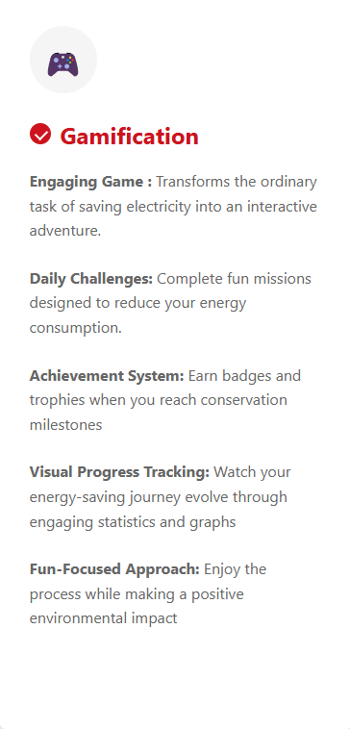
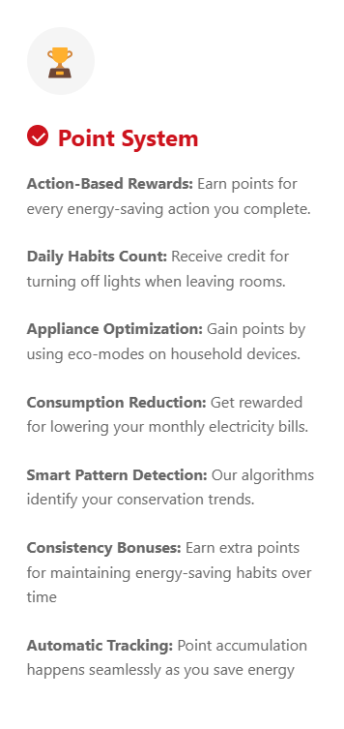
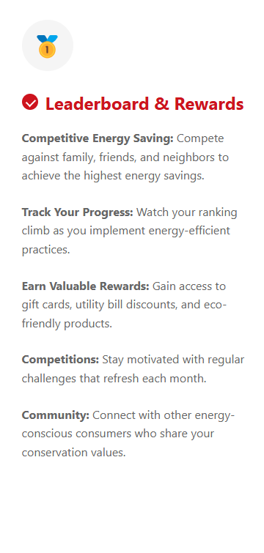
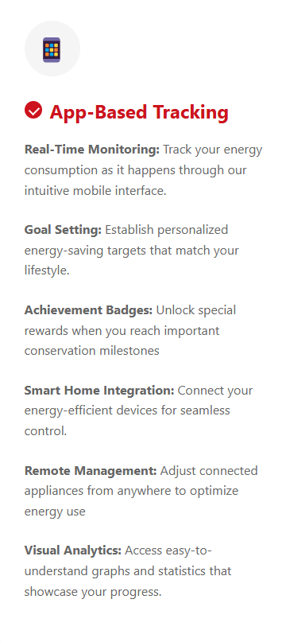
GET A GLIMPSE OF OUR APP

Slide 7
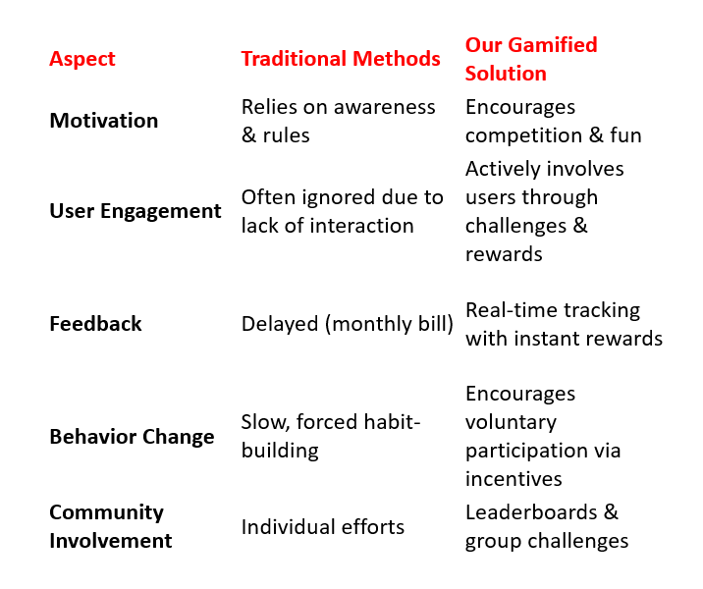
WHY WE’RE CONFIDENT THIS WILL SUCCEED?
Different from traditional energy-saving methods because it uses gamification to drive engagement and behavior change rather than just relying on awareness campaigns or strict policies

Slide 8
Integrating Smart Homes with Gamification
Automated Tracking & Points System
Smart meters and sensors automatically track energy usage.
Users earn points for turning off appliances, using eco-modes, or lowering consumption.
Leaderboard & Rewards System
A real-time leaderboard shows top energy savers within a household or community.
Families or neighborhoods can compete to save the most energy each month.
Rewards (discounts, vouchers, or incentives) can be given for top performers.
Challenges & Badges
Weekly or monthly challenges (e.g., "Reduce energy by 10% this month") to earn badges.

Slide 9
Alternative Ways to Track Energy Without Smart Appliances
Electricity Bill-Based Tracking
Users manually input their monthly electricity usage into the app.
The app compares it with previous months and rewards points for reductions.
Smart Plugs & Low-Cost Sensors (Optional for Those Who Can Afford)
Smart plugs (~₹500-₹1500) can track usage for major devices like TVs, refrigerators, and fans.
Self-Reported Actions
The app allows users to log energy-saving activities like:
Turning off unnecessary lights.
Using a fan instead of an AC.
Running a washing machine on an eco-friendly cycle.

Slide 10
Revenue Model of Electricity App An Overview of the Income Sources
The electricity app generates revenue from two primary sources:
1. Subscription Revenue: Users can pay ₹50 for an ad-free experience.
2. Ad Revenue: Users who do not subscribe will see advertisements, generating revenue.

Slide 11
Subscription-Based Revenue
• Users can pay ₹50 per month to remove ads.
• This ensures a steady and predictable revenue stream.
• Encourages a better user experience without distractions.

Slide 12
AD REVENUE MODEL
• Users who do not opt for the subscription will see ads.
• Revenue is generated through:
- Banner ads
- Video ads
- Sponsored content
• More users mean higher ad revenue potential.

